Slide 1


College info for dreamers
Osborne High School Counseling Department
Last Updated: 10/21/2025
Notes:
Welcome to the Osborne High School presentation of College 101 for DREAMers. We created this presentation specifically for students who are either undocumented noncitizens or are DACA recipients, also known as DREAMers. We wanted to provide you with a resource that will serve as a guide for opportunities available for you. The opportunities are constantly changing and we plan on updating as more information comes out. This presentation provides information as of October 7 2021. If you have any questions or need clarification, please reach out to your Osborne School Counselor.

Slide 2
Who are the DREAMers?
DREAMer refers to a person living in the US without official authorization since coming to the country as a minor
DREAMers may be DACA recipients or they may be eligible to receive DACA but have not applied
Notes:
Who are the DREAMers? The term DREAMer is used to refer to a person living in the United Stated without official authorization since coming to the country as a minor. DREAMers may be DACA recipients or are undocumented noncitizens who may be eligible to receive DACA but have not applied to receive it.

Slide 3
What does it mean to be an undocumented noncitizen?
This refers to an individual who is residing in any given country without legal documentation
  Undocumented noncitizens can come from any country
  Ex. Someone who entered the United States without proper inspection and permission from the new country
  Ex. Those who originally entered the United States with a Legal Visa that is no longer valid
Notes:
Someone who is residing in any given country with legal documentation is considered to be an undocumented noncitizen. Undocumented noncitizens can come from any country and can have a variety of reasons for why they are undocumented. Some reasons may be the individual entered the county without proper inspection and permission from the government, or individuals who did enter the country with a legal visa are now considered undocumented noncitizens if that visa is no longer valid.

Slide 4
What is daca?
Deferred Action for Childhood Arrivals: Immigration policy that allows individuals brought to the United States as a child to receive a renewable two-year period of deferred action from deportation and work towards receiving a work permit
  A Court ruling on July 16, 2021 states that current DACA Recipients can submit renewal requests, but initial requests are not being process at this time
DACA can be renewed at this time- must be renewed every two years
  Submit renewal request 4-6 months before DACA expiration
Resources about DACA:
  Immigrant Legal Resource Center: https://www.ilrc.org/
  DACA Initial Application Guide: https://www.ilrc.org/daca-initial-app-guide
  DACA Renewal Guide: https://www.ilrc.org/how-to-complete-a-daca-renewal
NOTE: DACA policy is under ongoing court review. Always check with official sources (USCIS or ILRC) for current updates.
Notes:
First and foremost, let’s talk about DACA. DACA stands for Deferred Action for Childhood Arrivals. This is an immigration policy created by President Obama that provides a two year protection against deportation for individuals who were brought into the United States from any country as a child. The Biden Administration has re-instated DACA after it was suspended in September 2017. Currently, DACA recipients can apply for renewal for two years. A court ruling in the Summer of 2021 has put initial DACA requests on hold for being approved. While initial DACA applications can be submitted, they are not being approved at this time.
DACA renewals should be submitted 4-6 months before they are set to expire. Some resources about DACA are listed here.

Slide 5
Family Educational Rights and Privacy Act
(FERPA)
Federal law that protects the privacy of student education records
School officials cannot disclose immigration status about students without their express permission
If you are a DREAMer (i.e. you are a DACA recipient or are an undocumented noncitizen), please speak with your School Counselor about opportunities
  That information will not be shared!
Notes:
There is a lot of fear surrounding the topic of being undocumented. Students are protected by the Family Educational Rights and Privacy Act, also known as FERPA. FERPA was created to protect the privacy of the student and their education records. School officials cannot disclose immigration status about students with their express permission. If you are a DREAMer, you can share that information with your school counselor so they can best help you with your college application process. Your information will not be shared with anyone else- you are safe with your school counselors.

Slide 6
Georgia policies on attending college
Only three colleges in the state of Georgia do not accept DREAMers
  University of Georgia
  Georgia College and State University (GCSU)
  Georgia Tech
All other public colleges in Georgia may admit undocumented students, but will charge out-of-state or international tuition
Notes:
Almost all colleges and universities in the state of Georgia accept Dreamers into their school. Only three colleges in Georgia do not accept DREAMers. Those three colleges are the University of Georgia, Georgia College, and Georgia Tech. Additionally, Dreamers are not eligible for in-state tuition.

Slide 7
What does this mean?
ALL students, regardless of citizenship status, can attend college!
The biggest barrier is paying for college
Notes:
So, what does this mean? It means that all students can attend college in the state of Georgia. Your citizenship status does not have an impact on your ability to be accepted into most Georgia colleges and universities. The biggest barrier is how students will pay for college. We are about to discuss ways students can pay for college if they are undocumented or receive DACA.

Slide 8
FAFSA
Free Application for Federal Student Aid- Can be completed after October 1st of senior year to become eligible for federal aid, state aid, and financial aid at college
  www.Fafsa.gov
Undocumented Students are NOT Eligible for Federal aid or State Aid in Georgia
Students must have a Social Security Number to complete the FAFSA
  Most Undocumented Noncitizens do not have Social Security Numbers
  DACA recipients with SSN can complete the FAFSA
DACA Recipients can complete the FAFSA for institutional purposes (to qualify for college-based aid) but they are not eligible for federal or state financial aid
Parents & Guardians do not need a SSN to complete their portion of FAFSA
To answer more specific questions: https://studentaid.gov/apply-for-aid/fafsa/filling-out/undocumented-students
Notes:
The Free Application for Federal Student Aid, also known as the FAFSA, must be completed by students after October 1st of their senior year to be eligible for federal and state aid; however, undocumented students and students with DACA are NOT eligible for federal or state aid in Georgia.
Does this mean you should complete the FAFSA? That depends on your situation. If you are undocumented, you will not have a Social Security Number and therefore cannot complete the FAFSA. If you are a DACA recipient with a Social Security Number, you can complete the FAFSA. Although you will not qualify for federal or state aid, you may qualify for financial aid from the college you are attending or private scholarship organizations.
If you are completing the FAFSA and your guardian does not have a Social Security Number, you will enter either all zeroes or all nines in the required spots. You will not be able to submit the FAFSA electronically, but you can print out the signature page and mail your application. If you are a DACA student completing the FAFSA, you can refer to the resource listed to answer more specific questions.

Slide 9
Cost of Attendance
DREAMers are NOT eligible for federal student aid or Georgia State Aid
  May be eligible for college financial aid or private scholarships from third parties
Undocumented noncitizens and DACA recipients are charged either out-of-state or International tuition
  This can be two to four times the rate of in-state tuition
Please check Naviance or the Counseling website to explore scholarship opportunities
  Many local scholarships are offered to students regardless of citizenship status
  Osborne Scholarship Page: https://osbornecounseling.wixsite.com/ohscounseling/scholarships-financial-aid
Notes:
As already stated, undocumented students and students with DACA are NOT eligible for federal student aid or state aid from Georgia, but they may be eligible for financial aid from the college and private scholarships. Colleges and universities in the state of Georgia classify DREAMers as out-of-state or international students. The tuition rates for those classifications can be two to four times more expensive than in-state tuition.
To research scholarship opportunities, students can check Naviance or the Osborne Counseling website for a list of scholarships.
Many local scholarships that are guaranteed to Osborne students do not require applicants to be a US citizen. Please check the Osborne website at the beginning of the second semester for a list of these local scholarship opportunities.

Slide 10
Scholarships for Hispanic students
Hispanic Scholarship Fund: https://www.hsf.net/
Hispanic Heritage Foundation: https://hispanicheritage.org/programs/leadership/youth-awards/
Hispanic Association of Colleges and Universities: https://www.hacu.net/hacu/Scholarship_Resource_List.asp
League of United Latin American Citizens: https://lulac.org/programs/education/scholarships/index.html
MALDEF: https://www.maldef.org/resources/scholarship-resources/
Golden Doors Scholarship: https://www.goldendoorscholars.org/
QuestBridge Scholarship: https://www.questbridge.org/
Golden Dream Scholarship (DACA Recipients): https://docs.google.com/forms/d/e/1FAIpQLSchU1DGPdNNL0vfgN9YIvKD5in1uJHx4aYR2sw6B3QeiuD2Gg/viewform?pli=1&gxids=7628
Notes:
There are many scholarships specifically for Hispanic students. Many of these scholarships provide opportunities for DREAMers to afford college. Please take the time to explore these scholarships for more information on how to apply.

Slide 11
Private colleges
Many private colleges offer financial aid packages that meet 100% of financial need
  e.g. Oglethorpe University and Emory University
List of colleges that meet 100% of financial need for most or all students:
  https://www.thecollegesolution.com/list-of-colleges-that-meet-100-of-financial-need/
List of colleges that meet 100% of financial need for DREAMers:
  http://blog.collegegreenlight.com/blog/colleges-that-meet-100-of-financial-need-for-undocumented-students-in-2019-2020/
Notes:
Many private colleges offer financial aid packages that meet 100% of financial need. Oglethorpe University and Emory University are two examples of private colleges in Georgia that accept students regardless of citizenship status and award financial aid to those who demonstrate financial need. Students who are admitted into private colleges will complete a financial aid form that requests information about their household’s income- this is similar to the Free Application for Federal Student Aid. Based on the information you provide about your household’s income, the college may offer a scholarship to help cover the cost of attendance. For a list of college that meet 100% of financial need for all students and specifically for undocumented students, please click on the resources listed.

Slide 12
Online College Programs
Some Georgia colleges and universities offer online programs that charge the same tuition regardless of residency status (out-of-state, in-state, international)
Georgia Perimeter College:
  Perimeter College Online: https://perimeter.gsu.edu/admissions/online/
  Current tuition- $105/credit hour
eCore and eMajor
  eCore: Students can take intro-level core classes online from any USG professor
  eMajor: Select majors can be taken through eMajor
  Current Tuition- $159/credit hour for eCore; $199/credit hour for EMajor
College online Options:
  Check with the college’s online options (programs offered) and tuition rates to determine if it is a right fit
  Some examples will follow
Notes:
We are excited to share information about online college programs. We have two local colleges that offer online programs that charge the same tuition rate regardless of residency status.
Georgia Perimeter College offers online programs for students earning their associate’s degrees. The Current tuition is $105 per credit hour. Georgia Perimeter College is the two-year college associated with Georgia State University.
Georgia Highlands College offers an online e-core program. This program allows students to take their core classes online at a rate of $159 per credit hour. Students taking e-core classes would be a Georgia Highlands student, but the class could be taught by a professor in another college. For example, a Georgia Highlands student’s e-core class could be taught by a professor at Georgia State University.
Kennesaw State University offers online programs for students earning a bachelor’s degree. The tuition for a typical online program costs $199 per credit hour. Please keep in mind these rates are for tuition only. It does not factor in fees that are charged from the school. Even with the tuition and fees combined, These rates are much lower than the out-of-state tuition or international tuition that is typically charged for undocumented and daca students.

Slide 13
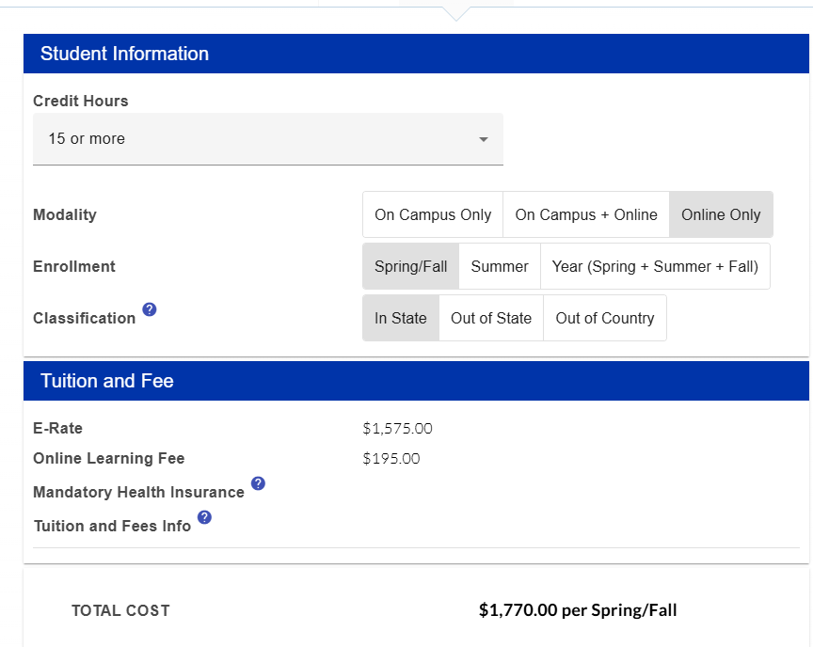
Perimeter College online tuition & Fees
GSU Tuition Calculator:
https://perimeter.gsu.edu/student-financial-services/tuition-and-fees/#1497015680848-675e3982-bb97
Notes:
Georgia State offers a tuition calculator that calculates the total cost of attendance for students enrolled in the online program. This screen shot shows the total price for a student who is enrolled in the online perimeter college program. This particular student signed up for 5 classes, which is typically 15 credit hours. The total price for tuition and additional fees is $1,770.
The Link to the Georgia State Tuition Calculator can be found on this screen.

Slide 14
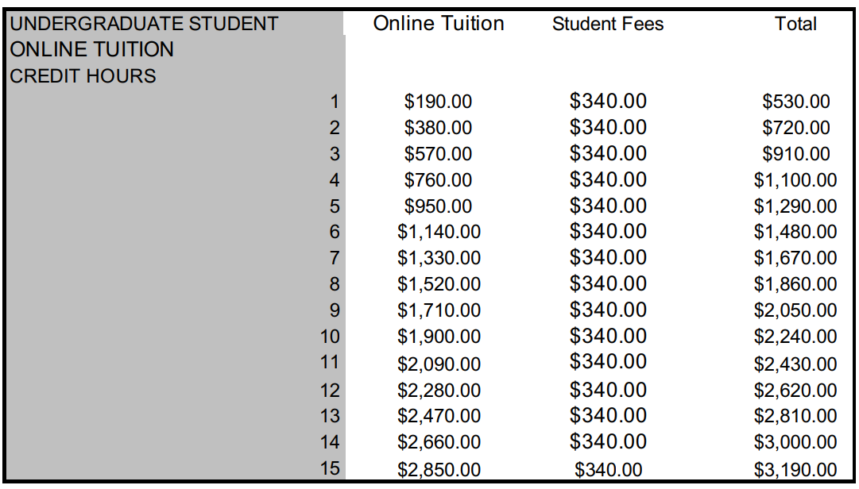
Kennesaw State University E-Tuition & Fees
KSU Online Information: https://www.kennesaw.edu/ksu-online/index.php
Notes:
For a list of tuition and fees for Kennesaw State University’s online undergraduate program, take a look at the rates listed in the top left table. For this academic year, if a student takes 12 credit hours, which is normally four classes, they would be paying a total of $2,579.80 per semester for tuition and fees. If a student take 15 credit hours, which is normally five classes, they will pay 3,136.00 per semester for tuition and fees.
If you look under student fees column in the middle, you will notice the fees will increase if a student is taking more than four credit hours. Again, these rates are for students who are taking only online classes. This also does not include housing fees if the student is living on campus.

Slide 15
Ecore
Online program throughout Georgia that includes 23 participating University System of Georgia colleges
You will take a general education class that may be taught by a professor at another university and include students from several other universities
Flexible times (no set class time), classes will transfer if students transfer to another Georgia college
Students will register for eCore classes through the college they are enrolled in
Tuition: $159/credit hour
Full time student= 12-15 credit hours (4-5 classes)
15 credit hours x $159= $2,385 tuition per semester + Fees
12 credit hours x $159= $1,908 tuition per semester + Fees
Notes:
E Core is an online program available for 23 college in Georgia. Students would have to be attending one of the participating colleges to take eCore classes. Ecore classes are online classes that may be taught by professors at another university and will include students from other universities. There is a lot of flexibility with these types of classes since there is not a set class time. Credits for these classes will transfer if a student transfer to another Georgia College. Students can register for the eCore class through the college they attend. The cost is $159 dollars a credit hour. For five classes, students should expect to pay about $2,400 a semester for school.

Slide 16
ecore
Website: https://ecore.usg.edu/
Georgia Highlands College Ecore Programs: https://ecore.usg.edu/about/institutions/georgia-highlands-college
Kennesaw State University Ecore/emajor Programs: https://ecore.usg.edu/about/institutions/kennesaw-state-university
University of West Georgia Ecore Programs: https://ecore.usg.edu/about/institutions/university-of-west-georgia
Notes:
Here are resources for more information about eCore. Three universities that work largely with Osborne high school are Georgia Highlands Colleges, Kennesaw State University and University of West Georgia. These three colleges do have eCore classes, so students who enroll in these colleges can register for eCore classes and pay $159 per credit hour for tuition.

Slide 17
Two-year/technical colleges
Tuition for two-year and technical colleges is less expensive than four-year colleges and universities
Students who attend a two-year or technical college can earn their associate’s degree (Two-year college degree)
  Diploma and Certificate programs are also available
Local: Chattahoochee Technical College charges out of state tuition for non-residents
  $214 per credit hour
  15 credit hours x $214 = $3,210 tuition per semester
  6 credit hours x $214 = $1,284 tuition per semester
Notes:
Another option for students to pay less for college is to attend a two-year or technical college. If you noticed in the previous slides that broke down the rates for the online programs, Perimeter College’s rates were significantly lower than Kennesaw State’s rate. Perimeter College, which is a two year college, is going to be less expensive than Kennesaw State, a four year university. Tuition for two year college and technical colleges will be lower than four year colleges.
Students who attend a two year or technical college could earn their associate’s degree, which is a two year degree. They also could earn a certificate or diploma. Certificates and diplomas are evidence a student has completed education or training in a specific field. A diploma will take longer to earn than a certificate, but still is not considered a college degree.

Slide 18
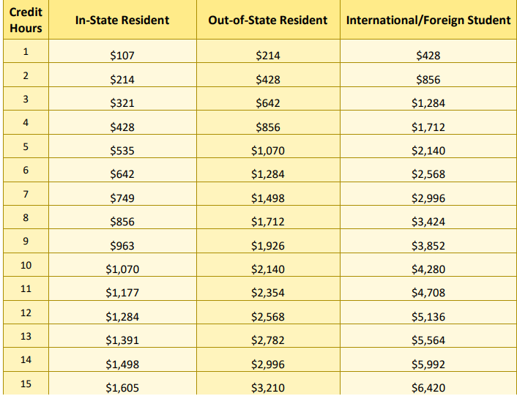
Chattahoochee Technical college tuition
https://chattahoocheetech.smartcatalogiq.com/2021-2022/General-Catalog/Tuition-and-Fees
Notes:
Chattahoochee Tech charges Dreamers as out-of-state residents. That means tuition would be $214 per credit hour. For 12 credit hours, roughly four classes, students would pay $2,568 in tuition per semester. For 15 credit hour, roughly five classes, students would pay $3,210 in tuition per semester. There will be additional fees to cover campus expenses, which adds up to around $400 extra per semester.

Slide 19
Dual Enrollment
High School students can take college classes at no cost regardless of immigration status
Students can earn both high school and college credit
Students will graduate high school with college credits
If you are interested in Dual Enrollment, please speak with your School Counselor
For more info: https://www.gafutures.org/hope-state-aid-programs/scholarships-grants/dual-enrollment/frequently-asked-questions/
Osborne High School Dual Enrollment Info: https://osbornecounseling.wixsite.com/ohscounseling/dual-enrollment
Notes:
Dual Enrollment is a program that allows high school students the opportunity to take college classes for free regardless of immigration status. Students who are participating in the Dual Enrollment program would take college classes that count as both college and high school credit. This means the college class they take in high school would be listed on their high school transcript and their college transcript. Students can earn up to 30 college credit hours, which is roughly ten classes. If you are interested in Dual Enrollment, please speak with your school counselor. More information about Dual Enrollment can be found on GAFutures and the Osborne Counseling website.

Slide 20
Modern States: “Freshman year for free”
Students can enroll in FREE core classes (Math, Science, Social Studies, English) online that teach subject material at your own pace
  Just need computer and internet access
After completion of the course, students can take the CLEP exam (Cost is $97)
  If the CLEP Exam is passed, students could be granted college credit by the college they enroll in
Could potentially earn credit for 8 college classes
Modern States Website: https://modernstates.org/
Notes:
Modern States is a program that allows people to enroll in free online classes for math, science, social studies and English. After completing the course, students can pay $89 to take the CLEP exam for that course. If they pass the CLEP exam, they could be granted college credit by the college they eventually enroll in. Students have the opportunity to do this for 8 college classes. You can get more information by visiting the Modern States website.

Slide 21
Additional resources
Freedom University: https://freedom-university.org/home
Osborne High School Counseling Website: https://osbornecounseling.wixsite.com/ohscounseling
Notes:
Here are a few resources to help you in your college planning process. Freedom University provides tuition free college classes to undocumented youth unable to attend college due to the cost of attendance. Although the Freedom U classes do not count as college credit, national exams can be taken to potentially exempt Freedom U students from classes if they enroll in a public college or university.
Pebblebrook High School has a Spanish version of their counseling website that provides a lot of amazing resources for students.
If you have any questions at all, please reach out to your school counselor. We want to help you work towards your goals and plan for your future. Thank you for taking the time to listen to this presentation.

