Slide 1
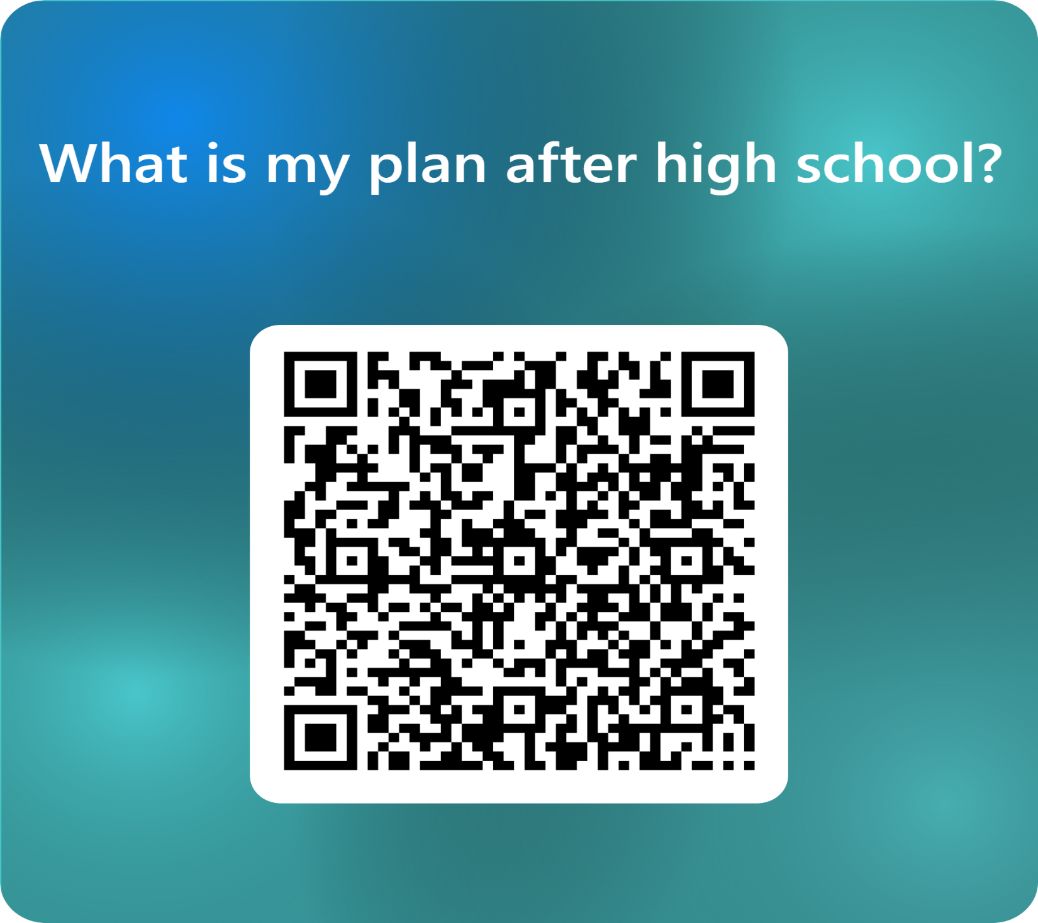

Slide 2
While you are waiting
Please turn on your computers and go to www.cobbk12.org
Inside your folder, you will find:
Your Individual Graduation Plan
Your HOPE GPA
QR code for access to the PowerPoint and the links

Slide 3


Welcome Class of 2027
Junior advisement

Slide 4
What is junior advisement?
Junior Advisement aims to help you plan for senior year and ensure you have all your Georgia high school graduation requirements.
There are four parts:
.
.
  PowerPoint Presentation – to provide you with further information about post-secondary options after graduating high school
  .
  Bridge Bill Survey – the state of Georgia requires all juniors to complete this survey in Naviance
  .
  Individual Graduation Plan (IGP) – allows students to view and plan out courses for senior year to meet academic and career goals
  1
  Check out with a school counselor – once you’ve completed the Bridge Bill and IGP, you will check out with any available school counselor in the media center’s main area

Slide 5
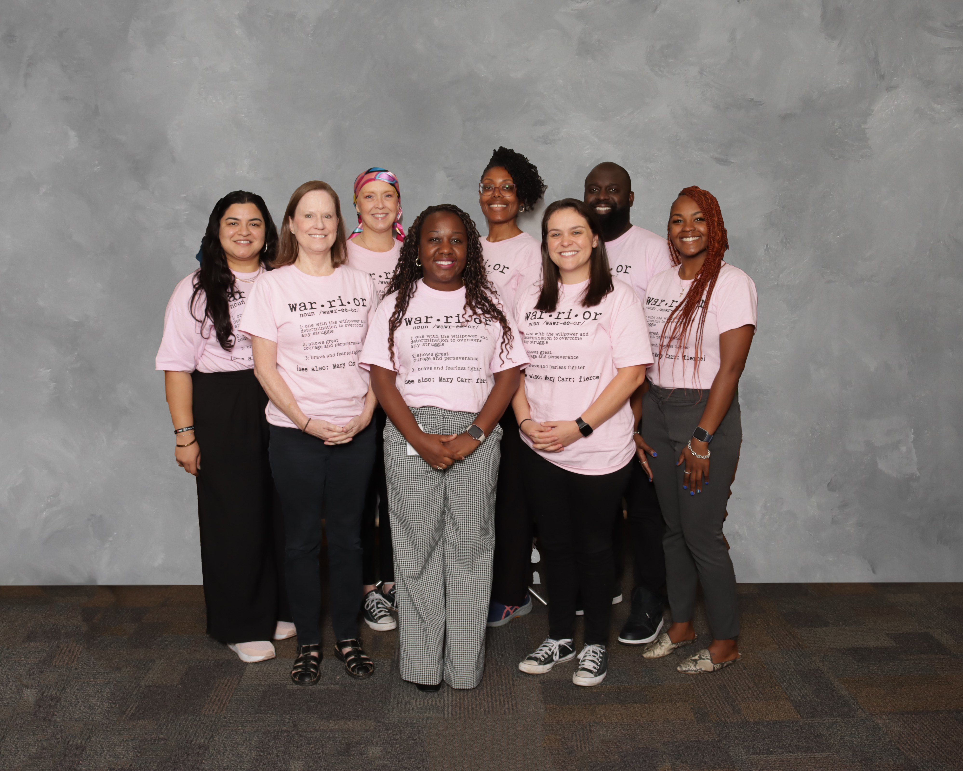

Meet the Team
Last Names A-E 9th-11th: Kismet Rhodes
Last Names F-L 9th-11th: Ashleigh Turner
Last Names M-Re 9th-11th: Michael Stringer
Last Names Rf-Z 9th-11th : Shirley Touze’
12th Grade Students: Maureen Foley-Talley
CITA: Dinaia Kilgore
Counselor Registrar: Ayesha Fawzi
Department Lead: Mary Smith
Counseling Clerk: Hilda Hernandez

Slide 6
LEARNING OBJECTIVE
Students will learn about college and career options (and the steps to achieve each option) in preparation for life after graduation.
Students will plan for their final semesters of high school with the purpose of developing a viable post-graduation plan.

Slide 7
Let’s talk about…
Junior Advisement & IGP
Graduation Requirements and Options
Post-Secondary Options
HOPE Programs, Financial Aid, and Georgia Match
Naviance
Dual Enrollment

Slide 8
JUNIOR ADVISEMENT & IGP

Slide 9
JUNIOR ADVISEMENT & INDIVIDUAL GRADUATION PLAN
The Individual Graduation Plan (IGP) will be completed in CSIS, using the link in Naviance.
All 11th grade students will receive advisement concerning remaining graduation requirements.

Slide 10
Graduation requirements & options

Slide 11
Graduation requirements
Area of Study | Required Credits
English | 4 credits
Mathematics | 4 credits (Alg 1, Geometry, Adv Alg)
Science | 4 credits (Biology, Physics/Physical Science, Chem/Earth/Env Sci)
Social Studies | 3 credits (World, U.S., Gov/Econ)
World Language/CTAE/Fine Art | 3 credits
Personal Fitness/Health (or 3 units of JROTC) | 1.0 credit
General Electives | 4 credits
TOTAL CREDITS TO GRADUATE | 23
Students planning to meet the requirements of a four-year college/university must complete a minimum of two units of the same World Language and complete Math above Advanced Algebra/Algebra II (FoA does not meet that requirement)
Notes:
Emphasize the requirement for World Language and higher-level Mathematics for 4-Year College acceptance.

Slide 12
DUAL ENROLLMENT ACCELERATED CAREER DIPLOMA
If you are 100% sure you don’t want to attend a four-year college immediately after high school, and you’re interested in going directly into the workforce with a particular skill, this option may be for you (with parent approval). With only 9 required traditional high school credits, this option affords students the opportunity to simultaneously graduate with a CCSD high school diploma and Chattahoochee Technical College credentials.
Contact your assigned school counselor for more information if you are interested.
Notes:
This is an alternate route toward high school graduation.

Slide 13

Dual enrollment accelerated career diploma high school requirements
American Literature and 1 additional English course
Algebra I and 1 additional Math course (Foundations of Algebra works!)
Biology and 1 additional Science course
Econ/Gov and United States History OR World History
Health and Personal Fitness
Completion of two technical certificates, one technical diploma or an Associate’s Degree

Slide 14
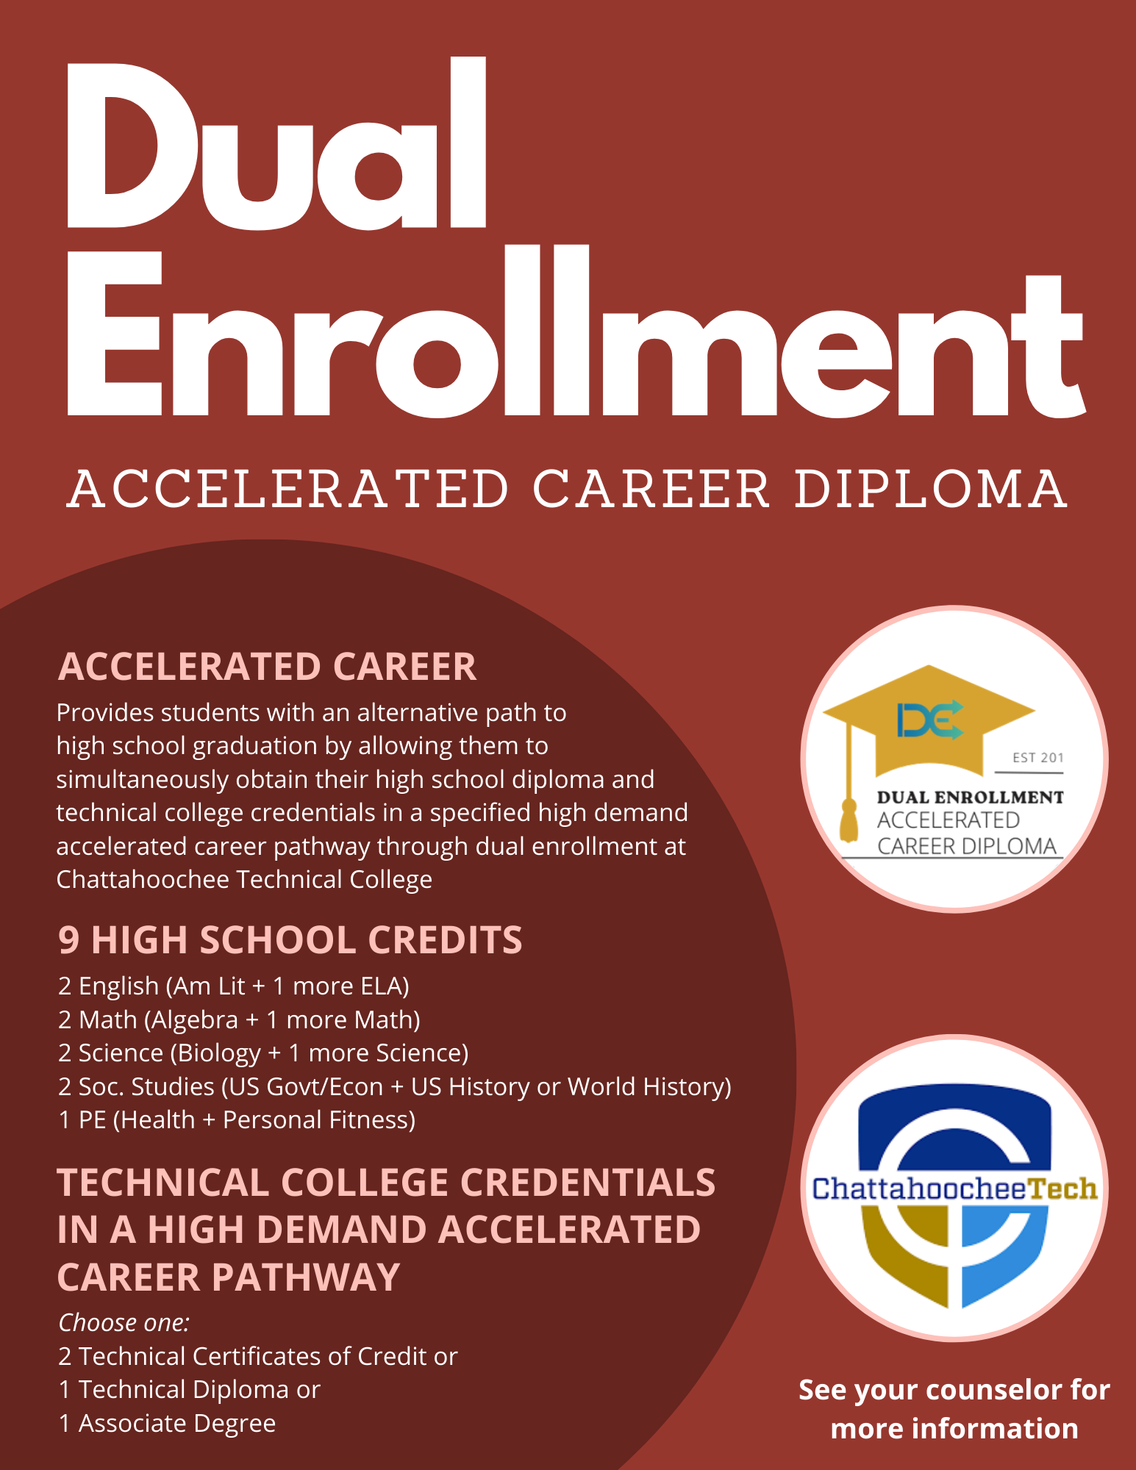

Chatt Tech
Accel Career Pathways

Slide 15
DUAL ENROLLMENT

Slide 16
Dual Enrollment (DE)
Dual Enrollment is a program that allows 10th - 12th graders to take college classes while completing their high school diploma. Students receive high school credit towards graduation and receive the college credit.
DE pays for 100% tuition, mandatory fees, and required textbooks up to a maximum cap of 30 hours (this equates to roughly one year of full-time college enrollment or around 10 courses)
DE students can take approved courses in: English, math, science, social studies, or world/foreign languages AND/OR Career Tech (CTAE) classes.
The goal of Dual Enrollment is to increase college access and completion and prepare students to enter the workforce with the skills they need to succeed.
If you’re interested in Dual Enrollment, make an appointment with your assigned counselor.
Notes:
Each school can edit the 5th bullet to add their school-specific next steps for interested students (i.e., talk to counselor, attend information session, etc.)
Counselors can lessen the information on the slide for visual purposes but be sure to share all info.
Here are the benefits to DE – you can present these to your students as appropriate:
Introduces students to college-level coursework.
• Earning college credits while still in high school may enable students to graduate early
and/or possibly even earn an associate degree, diploma or certificate.
• Helps students adjust to certain aspects of the college experience (e.g., classes, coursework,
and instruction, being on a college campus) so the transition from high school to college may
be easier.
• Students who participate in a dual enrollment program are more likely to go to college and
get a college degree.
• Students may be able to take classes that are not offered at their high school, especially in
subject areas they are interested in for a potential career.
• Participating in a dual enrollment program demonstrates a student’s ability to handle more
difficult coursework which is something college admissions officers may look upon favorably
during admissions and recruiting.
• Taking college-level classes while still in high school may build confidence and encourage
those students who may not be thinking about college to reconsider.
DE yields college credit upon successful completion of the course as opposed to AP courses in which students are only awarded college credit with a qualifying AP Exam score.

Slide 17
Interested in dual enrollment?
Contact your counselor to determine the process for scheduling a meeting to determine DE classes, complete paperwork, and inquire about deadlines set forth by your high school
Research your DE college’s admissions requirements and deadlines
Apply to the college:
  Submit SAT/ACT/Accuplacer scores (take these ASAP!)
  Request official transcript from School Counseling office
Attend the scheduled meeting with your DE counselor to make final decisions about DE classes and submission of required documents
Just a few things to consider:
Full-time or part-time participation
Whether your future college will accept transfer credits
How your future college might compare DE vs. AP
Are you ready for college level classes?
Transportation and parking
Potential schedule complications, both in-school and extracurricular (especially for part-time participation)
Cobb County and college calendars are different — exam dates, spring/fall/winter breaks will be different

Slide 18
Post-secondary options

Slide 19

What do I need to know?
What is my path after high school?
What are the requirements to get there?
What tests should I take?
How do I pay for it?

Slide 20

Post-secondary options
Apprenticeships and Job Training
Military
Specialty School
2-Year and/or Technical College
4-Year College/University
Other?
Notes:
On-the-job training: Short-term or long-term training is provided by an employer at the beginning of a new job
Military: 6-11 weeks of basic training when you join the Army, Navy, Air Force or the Marines
Specialty school: Enroll in schools like Full Sail, Nashville Diesel, Cordon Bleu, Paul Mitchell, etc.
Technical School: Enroll in a certificate or diploma program to prepare for a specific career
2-year community college: Earn an Associate’s degree or take courses that will transfer to a 4-year college/university
4-year college/university: Earn a Bachelor’s degree for a broad-based education and a specific education in a chosen subject area, or major

Slide 21
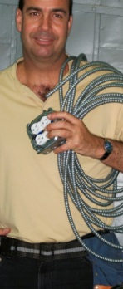



Trades and Apprenticeships
Occupations such as skilled construction work are considered trades or crafts.
The completion of an apprenticeship is generally associated with skilled labor. Training lasts 1 - 5 years, and provide on-the-job training, often paid. These kinds of programs can lead to secure and well-paying jobs. Additional education and training can provide high levels of advancement and increased salaries.
Notes:
Emphasize that there are some excellent and very well-paying careers that offer apprenticeships or on the job training. Most apprentices are paid while they work, reducing the burden of student loan debt and accelerating individuals into well paying and stable careers.
Counselors can lessen the information on the slides if needed for visual reasons but be sure to share all info!

Slide 22
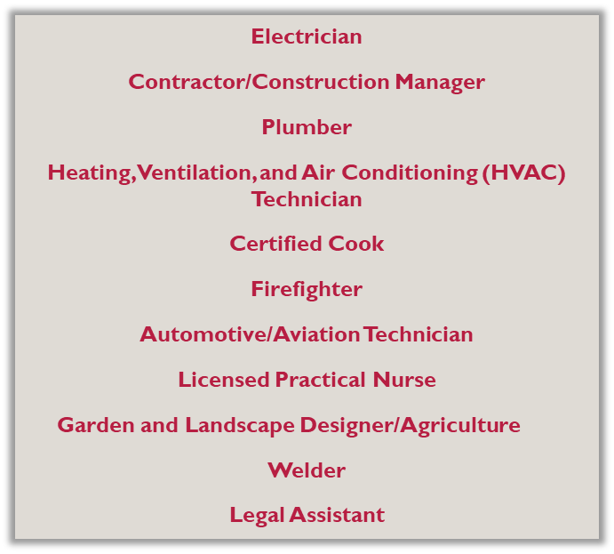




Trade Examples

Slide 23




Apprenticeships & Workforce
On-the-job training
Provided by employer
Related to skilled labor and training for actual jobs
Can lead to higher-paying secure jobs

Slide 24

https://youtu.be/hkFpsILh3pc
Notes:
This embedded video of Mike Rowe discussing the “skills gap” can transition you to the next slide about the State Workforce Development Initiatives.

Slide 25

State Workforce development initiatives
https://linktr.ee/GAWorkForceDevInitiatives
Visit the linktree listed above (or scan the QR code below) to learn about several workforce development initiatives in Georgia.
HOPE Career Grant
The HOPE Career Grant can be the boost a student needs to get started on a rewarding career in a well-paying job, and without accumulating a lot of student debt. It also helps Georgia employers by creating a pipeline of skilled workers they can hire well into the future.
To be eligible for the HOPE Career Grant, students must first qualify for and be receiving the HOPE Grant. The two grants together will cover all tuition in these 17 programs of study.
  https://tcsg.edu/free-tuition/
  https://www.gafutures.org/hope-state-aid-programs/hope-zell-miller-grants/hope-career-grant/
Notes:
In pairs or small groups, have students research and then share with the group about one of these state workforce development initiatives. Use the linktree QR code or link as listed to help their research

Slide 26
HOPE Grant + HOPE CAREER GRANT =
FREE TUITION
These programs are in High Demand and can be studied at a Technical College Tuition Free.
There is no GPA requirement to earn the HOPE Grant and HOPE Career Grant out of high school!
Automotive Technology
Aviation Technology
Certified Engineer Assistant
Commercial Truck Driving
Computer Programming
Computer Technology
Construction Technology
Diesel Equipment Technology
Early Childhood Care and Education
Electrical Lineman Technology
Health Science
Industrial Maintenance
Logistics/Transportation Technology
Movie Production Set Design
Practical Nursing
Precision Manufacturing
Welding and Joining Technology
Learn more at https://tcsg.edu/free-tuition

Slide 27
Military and Military Academies
Military Branch | Website | Military Academy
Army | www.army.mil and www.goarmy.com | U.S. Military Academy (West Point) – www.westpoint.edu
Navy | www.navy.mil and www.navy.com | U.S. Naval Academy – www.usna.edu
Air Force | www.af.mil and www.airforce.com | U.S. Air Force Academy – www.usafa.af.mil
Marine Corps | www.marines.mil and www.marines.com | Future Marines attend the U.S. Naval Academy
Coast Guard | www.uscg.mil and www.gocoastguard.com | U.S. Coast Guard Academy – www.uscga.edu
Speak with a recruiter to learn about opportunities available in the military.
Excellent scholarships are available for students who pursue ROTC in college.
Take the ASVAB for career placement and branch eligibility.
Military academy appointments are highly competitive, and students accepted attend completely FREE.

Slide 28
Requirements:
They are not the same
High School Graduation
College Admissions
Requirements are determined by the GA Department of Education (GaDoE)
Requirements are tracked by you, your teachers, and your school counselor.
Meeting minimum requirements guarantees graduation.
There are 23 required credits in specific areas.
Foundations of Algebra can meet 4th Math credit requirement.
World Language is not required.
Requirements and acceptance are determined by the individual college.
Requirements are tracked by you – it is your responsibility to find out what the school requires.
Meeting minimum requirements does not guarantee acceptance.
Requires standardized testing (Accuplacer, SAT, or ACT)
4-year colleges require Mathematics beyond Advanced Algebra and 2 years of the same World Language (ex: Spanish 1 and 2, French 1 and 2)
Notes:
Talking points:
Meeting minimum admissions requirements does not guarantee admissions
Refer to freshman profile on college websites
College admissions requirements are often greater than graduation requirements (even in GA)
It is the student’s responsibility to know the college admissions requirements

Slide 29
What does “College” mean?
Specialty School (certificate or diploma)
2-year and/or Technical College (certificate, diploma or Associate’s degree)
4-year College/University (Bachelor’s degree)
There are several types of schools someone with a high school diploma can attend to earn an undergraduate degree or certificate.

Slide 30
How do I get into college?
Research colleges and universities online
Attend college fairs and info sessions
Make a list of potential schools
Schedule college visits (virtual and in-person) when possible
Build your list
  Add interested colleges to “Colleges I’m Thinking About” in Naviance
Define Your Priorities
  Location, Size, Major, Cost
  Look at Freshman Profile
  Admission Requirements
Do Your Research
  SuperMatch in Naviance
Find Balance
  5-7 colleges
  Safety, Target, and Reach colleges
Notes:
Talking points:
Include in your list of potential schools:
reach(dream) school – student’s core GPA and test scores are below the college’s freshman profile OR the school is highly competitive
target schools – student’s core GPA and test scores match the college’s freshman profile
safety schools – student’s core GPA and test scores are above the college’s freshman profile
Online resources include: GAfutures, Big Future (College Board), etc.

Slide 31

Application Process: what you need to know
Apply during your Senior year
Remember: Your transcript will reflect your grades and coursework through Junior year. As always, do your best in all courses!
Review each school’s application:
  Online application or Common App
  Transcript
  Test scores (send directly from ACT or College Board)
  Application fee (fee waiver for free/reduced lunch students)
  Recommendations (only if required by the college)
    Counselor Recommendation (or school evaluation)
    Teacher Recommendation (letter or form, typically a core teacher)
Know the deadlines! They are firm!
Notes:
Talking points:
Include in your list of potential schools:
reach(dream) school – student’s core GPA and test scores are below the college’s freshman profile OR the school is highly competitive
target schools – student’s core GPA and test scores match the college’s freshman profile
safety school – student’s core GPA and test scores are above the college’s freshman profile
Recommendations:
The teacher recommendation should usually be from a core teacher
Explain your school’s counselor recommendation policy
Deadlines: These are firm. Tell kids not to wait until the last minute because servers do go down and postal workers strike.
Reiterate that counselors do not send test scores

Slide 32
College entrance exams:
SAT v. act
SAT
www.sat.org
Questions often require application, reasoning and analysis.
2 sections: Math and Reading
No penalty for guessing
1600 maximum score
Free online practice: Khan Academy
ACT
www.actstudent.org
More straight-forward questions like those you may have seen on high school assessments
4 sections: Math, English, Science, Reading and optional Writing
No penalty for guessing
36 maximum score
Free online practice: ACT Academy
Test registration is through the SAT and ACT websites; not the high school or college. Most colleges will accept either test. Writing requirement varies by college. These tests are sometimes required for admissions to 4-year colleges and universities. Students can take BOTH. Students who receive Free or Reduced Lunch qualify for fee waivers. Please contact your school counselor if you think you qualify for a waiver.
Notes:
Talking points:
How do I register for these tests?
ACT will look more like tests they have taken before
SAT is a reasoning test
Go to Gafutures.org for more information

Slide 33
Other tests I may need
ACCUPLACER – Placement exam for two year and technical colleges. (Schedule to take this test at chosen college)
ASVAB – Aptitude/career exam required for entrance into the military that determines your eligibility for military jobs
It is the student’s responsibility to check with each individual college for all admission requirements.
Notes:
If offered by your school, taking the ASVAB on campus is a great idea because you do not have to report the scores. It gives students a chance to “preview” the exam before taking it at MEPS.

Slide 34
Hope, financial aid, & GA Match

Slide 35

Gafutures: all things hope, de, and more

Slide 36
Hope information
HOPE Scholarship
3.0 core GPA as calculated by the GSFC (www.gafutures.org)
  Can be earned in college
Must earn a minimum of 4 credits from the academic rigor course list prior to graduating from high school. (Review your HOPE transcript on GAfutures.org)
Two-year or four-year degree
Must graduate from a GA high school
Must be a GA resident for at least one year (Green Card or citizenship)
HOPE Grant
No initial GPA requirement
  2.0 GPA required after the first 30 credit hours
Technical certificate or diploma
Must have a high school diploma or GED
Must be a GA resident for at least one year (Green Card or citizenship)
Apply for HOPE by completing the FAFSA. Go to www.gafutures.org for more information on requirements and award amounts.
Notes:
Talking points:
Technical colleges offer two-year degrees as well as certificates and diplomas
Some technical certificates consist of core college courses so a student could obtain the certificate and then transfer credits to apply toward a two-or four-year degree.
Give students a copy of the included flyer on where to check their HOPE GPA on Ga Futures. Free copies can be ordered from Georgia Student Finance Commission at:
https://www.gsfc.org/gheac/order_loan/index.cfm?guid=&returnurl=https%3a%2f%2fsecure.gacollege411.org%2fHome%2fEducator.aspx

Slide 37
Zell miller scholarship information
3.7 core GPA as calculated by GSFC (www.gafutures.org)
1200 on the SAT or 25 on the ACT
Must earn a minimum of 4 credits from the academic rigor course list prior to graduating from high school. (Review your HOPE transcript on GAfutures.org)
Must graduate from a GA high school
Must be a GA resident for at least one year (Green Card or citizenship)
Go to www.gafutures.org for more information on requirements and award amounts

Slide 38
What classes count toward hope?
Core classes, academic electives, world/foreign language courses
All classes that begin with the following numbers:
  23. x: English
  27. x: Mathematics
  26.x: Science
  40.x: Science
  45.x: Social Studies
  60.x-64.x: World Languages
  ??.x: Additional courses approved for fourth year of science (such as computer science)
H.O.P.E. counts all courses that begin with the listed numbers, both required and elective courses.
Review course list at www.gafutures.org.
Review HOPE rigor requirements at www.gafutures.org
Notes:
Explain the course numbers using the first two digits of the course number so students understand that required courses and electives count for HOPE. See handout regarding rigor requirements.
Certain CTAE courses will count in the HOPE GPA as the fourth year of science.
High school credit earned in middle school does not count toward HOPE – only specific courses completed in grades 9-12 will count toward HOPE GPA.

Slide 39
Which Courses are Weighted for HOPE?
Honors courses do not earn additional quality points toward the HOPE GPA.
AP, IB, and Dual Enrollment core courses earn .5 additional quality points, but will not exceed a 4.0.
It is your responsibility to track HOPE eligibility on Gafutures.org. If you have not created an account and you are interested in the HOPE Scholarship program, we suggest that you create an account as soon as possible.

Slide 40
YOUR HOPE GPA IS NOT ON YOUR CCSD TRANSCRIPT!!!!
MONITOR YOUR HOPE GPA on www.gafutures.org

Slide 41
Look out for Georgia Match (fall of Senior year)
Georgia Match is a program that matches Seniors with Georgia colleges for which the student meets the current Freshman Index for guaranteed acceptance based upon the Junior Year HOPE GPA.
Students will receive a letter and can access the information through their GAfutures account, provided they created an account.
Students can request more information about matched colleges through the GAfutures platform.
Notes:
Reiterate that this information will come Senior Year and cannot be accessed at this time. This is just to give them a heads up. Encourage students to go to GAfutures for more information.

Slide 42

Notes:
Play Georgia Match video from the Gafutures website.

Slide 43
WAYS TO PAY FOR COLLEGE
SOURCE
Family Savings
Grants and Scholarships
  Based on specific requirements
  Does not have to be repaid
Loans
  Must be repaid after college (with interest)
Work-study Programs
  Student has a job on campus.
ADDITIONAL INFORMATION
Financial aid requirements are different for undocumented students.
There may be additional options as provided by the specific college.
It is the student’s responsibility to contact the college directly.

Slide 44
Nuts & bolts of finding free money
WHERE DO I FIND RESOURCES?
School Counseling Office and/or Career Center
College websites
Various online resources like GAfutures, Naviance, BigFuture (College Board), etc.
Current employer or parent’s employer
Community
Organizations in which you may be involved
HOW DO I GET THE MONEY?
Create a resume and prepare a personal statement so you will be ready to apply
Search for scholarships everywhere
Apply early and often – remember, scholarships have deadlines too!
Complete the FAFSA as soon as possible during Senior year. Student grants, loans, and work study are awarded through the FAFSA.

Slide 45
naviance

Slide 46
Naviance
Naviance is a delivery system and college/career search engine, but it also how we communicate with YOU and your parents, throughout the year.
Notes:
10th CC handout

Slide 47
Logging into Naviance
If you’re on a CCSD computer, then you will be automatically logged into Naviance.
You can access Naviance from the CCSD homepage, your school’s website, as well as your school counseling department’s website.
To log into Naviance from home, you will use the following:
User Name: | Password:
Microsoft 365 User Name | Microsoft 365 Password

Slide 48
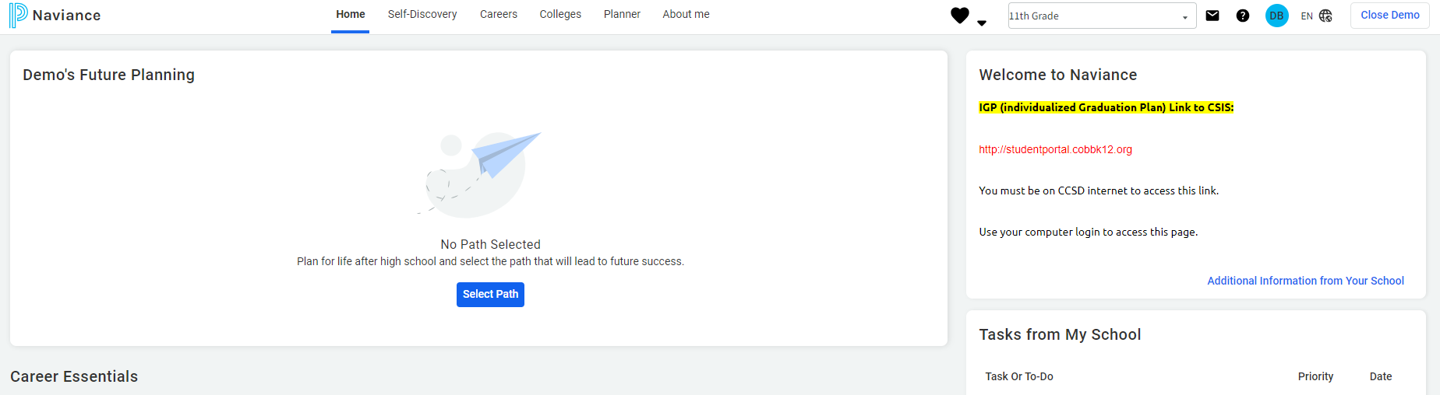
Naviance Student homepage
Notes:
This is the *NEW* Naviance home screen that students will see when they log in. Before beginning any activities, have the students click on "Select Path", review the pathways with them, and have them select their primary path. Students can also choose a secondary path if they are interested.

Slide 49
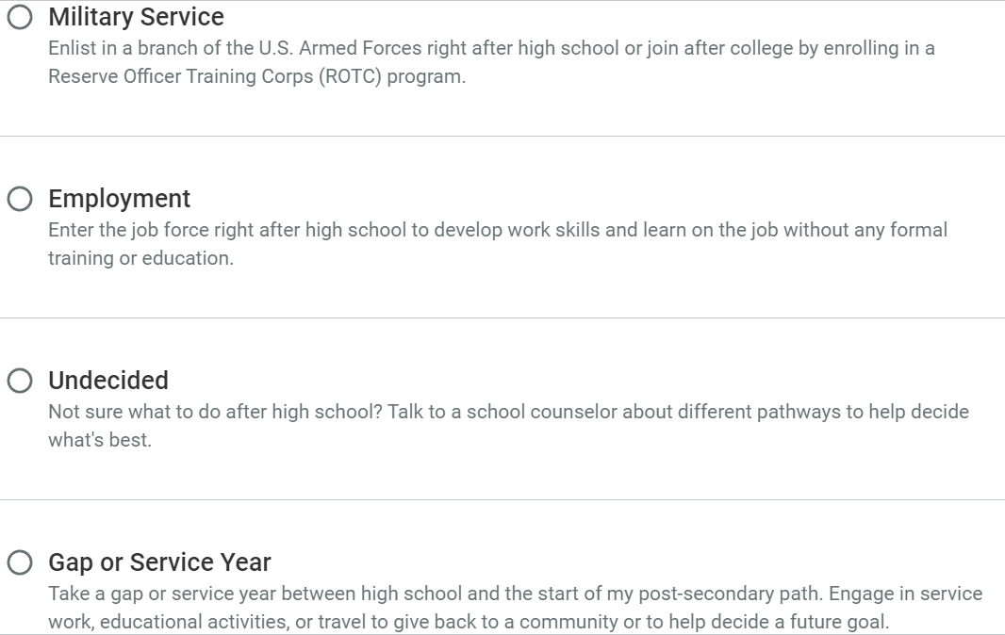
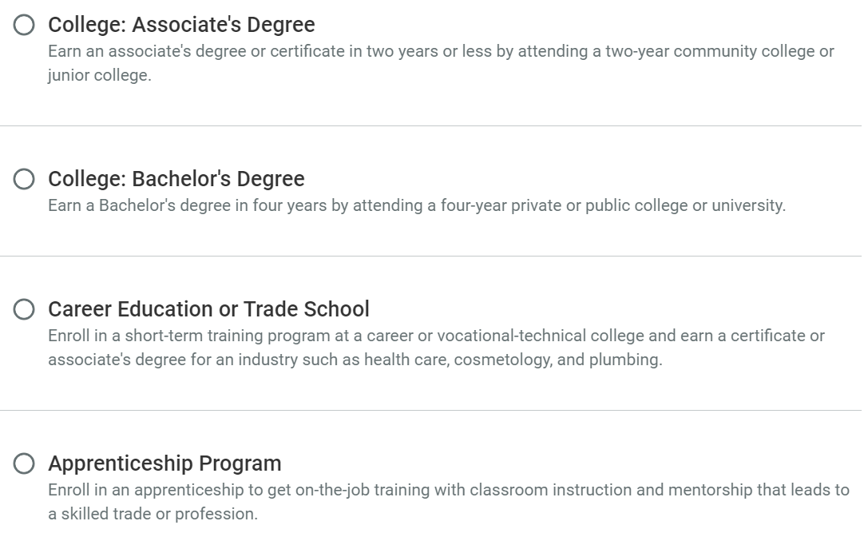
Select your path
YOU CAN ALSO CHOOSE A SECONDARY PATH IF YOU ARE STILL DECIDING!
Notes:
Choosing a path individualizes content on Naviance for each student. There are 8 pathway options:
College: Associate's Degree – earning a degree or certificate in 2 years (usually at a junior college or 2 year college)
College: Bachelor's Degree – earning a degree in 4 years by attending a private or public college or university
Career Education or Trade School – training programs usually at a technical college that earns you a certificate or associate's degree for an industry (e.g. health care, cosmetology, welding, plumbing)
Apprenticeship Program – on-the-job training (usually paid) that leads to a trade or profession
Military Service – enlisting in a branch of the military right after high school or joining after college (Army, Navy, Air Force, Marine Corps, Coast Guard, Space Force)
Employment – entering the work force right after high school with no formal training or education
Undecided – not sure yet
Gap or Service Year – taking a year off between high school and your post-secondary path (sometimes looks like volunteer or mission work depending on what your interests are)

Slide 50

Enter/update Your
Email Address
We need your personal email address so we can communicate important information with you. Please get in the habit of checking email frequently.
Click on the “About Me” link at the top.
Click on “My Account.”
Click on the Pencil Icon in the “Contact Information Box.”
Enter your personal email address.
Click “Save.”
Notes:
Make sure students enter in their personal email and not CCSD email

Slide 51
You can use Naviance for…
College and Career Planning
Resume Building
Communication with your Counselor
Scholarship Searches

Slide 52
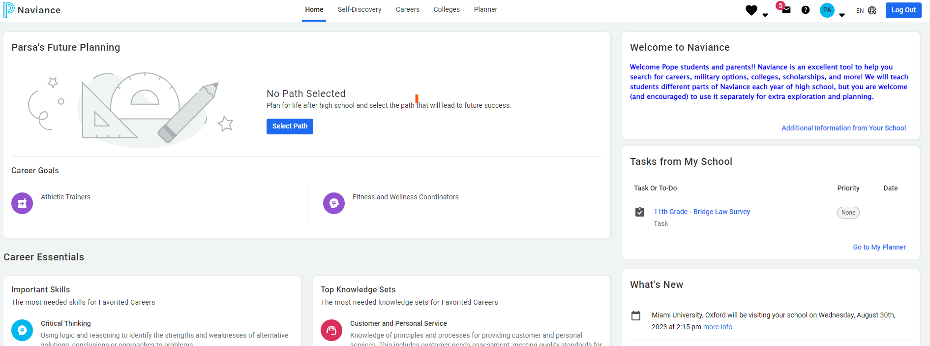
Bridge Law
On your dashboard home screen, tasks are on the right:

Slide 53

Complete the Junior Bridge Law Survey
Go to My Planner and click Tasks
Select 11th Grade - BRIDGE Law Survey
Select take this survey on the right side of the screen. Look for the pink diamond with a white arrow.
Click Start
Answer the questions and select Save and Finish

Slide 54
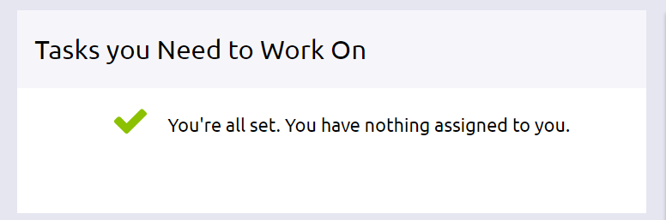
Don’t Log Out!
Wait for a counselor to confirm your completion
Go to My Planner and then Tasks to show completion status

Slide 55

“The best way to predict the future is to create it.”
- Abraham Lincoln
Just think about it ☺

